Slide 1
Origins of Gas Giant Compositions: The Role of Disk Location and Dynamics
Ana-Maria Piso
Advisor: Karin Öberg
Collaborators: Ruth Murray-Clay, Til Birnstiel, Andrew Youdin, Jamila Pegues
Thesis Advisory Committee: Matthew Holman, Sean Andrews, Dimitar Sasselov
TAC Meeting Presentation: March 9th , 2016

Slide 2
Outline
Brief Background Info
Research Accomplished Since Last Meeting
Next Steps
Proposed Defense Timeline

Slide 3
Outline
Brief Background Info
Research Accomplished Since Last Meeting
Next Steps
Proposed Defense Timeline

Slide 4
Disk Compositions Regulate Planet Compositions
Understand the disk well enough to:
Predict what kind of planet compositions result from planet formation in different parts of the disk
Back-track the planet formation location based on the planet composition

Slide 5
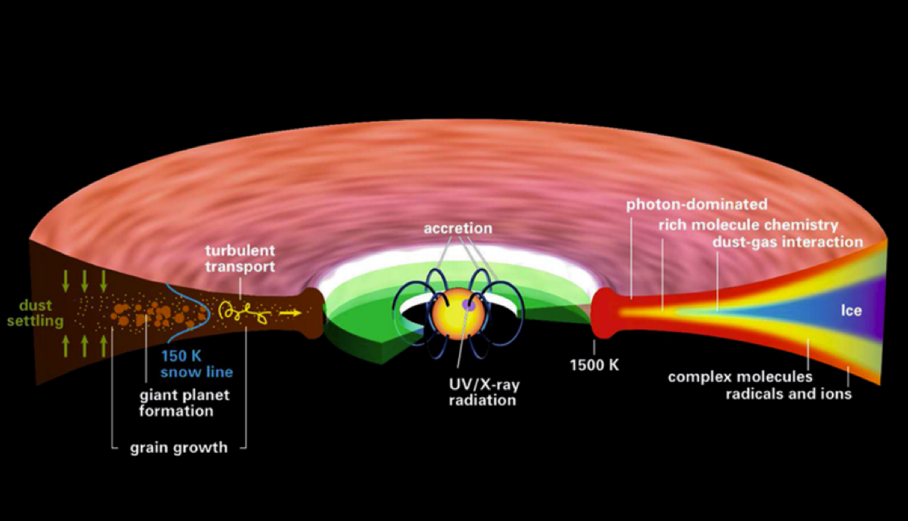
Disk structure is complex!
Henning&Semenov (2013)
Notes:
Remove the while and make the figure bigger.

Slide 6
Outline
Brief Background Info
Research Accomplished Since Last Meeting
Next Steps
Proposed Defense Timeline

Slide 7
Understand how DISK DYNAMICS and ICE MORPHOLOGY affect the snowline locations of the main C, O, N carriers, and thus the C/N/O ratios in gas and dust throughout the disk
GOAL

Slide 8
Piso, A.-M. A., Oberg, K. I., Birnstiel, T., & Murray-Clay, R. A. 2015, ApJ, 805, 109
C/O and Snowline Locations
in Protoplanetary Disks: The Effect of Radial Drift and Viscous Gas Accretion

Slide 9
We determined upper limits for the C/O ratio across the disk
Piso, Oberg, Birnstiel, Murray-Clay (2015)

Slide 10
Paper submitted to be submitted to ApJ by March 11
Piso, A.-M. A., Pegues, J., & Oberg, K. I.
The Role of Ice Compositions and Morphology for Snowlines and the C/N/O Ratios in Active Disks

Slide 11
GOAL
Expand the coupled drift-desorption model of Paper I by considering:
Additional volatile molecules and abundances (CH₄, N₂, NH₃)
Different ice morphologies
N/O ratios

Slide 12
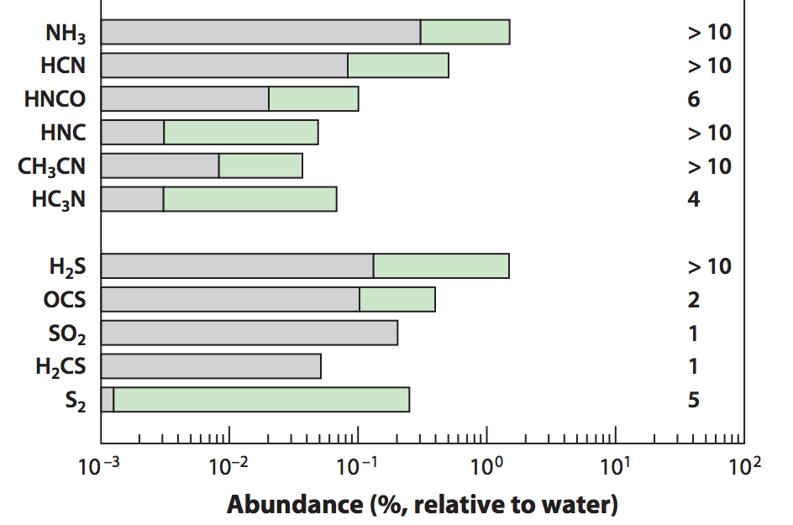
Volatile Abundances
Some C present in the form of CH₄
Add nitrogen-bearing molecules – nitrogen highly abundant in the Solar System and in disks and primarily found as N₂
Some N present in the form of NH₃
=> Use the median and maximum CH₄ and NH₃ abundances observed in protostellar cores from Spitzer c2d Legacy ice survey (Oberg et al. 2008, Oberg et al. 2011, etc.)
Mumma&Charnley(2011)
Notes:
Separate in two slides
Mention NH3 most abundant nitrogen carrier, bot low percentage of total N abundance => the rest in N2
Ice spectra or table
Show desorption curves from Edith’s paper

Slide 13
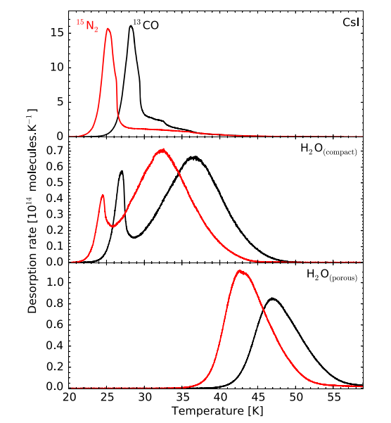
Ice Morphology
The binding energies of CO and N₂ vary by a factor of ~1.7 depending on whether CO and N2 are pure or water dominated ices
Fayolle+16

Slide 14
More volatile snowlines in disks
Piso, Pegues, Oberg (2016, in prep)

Slide 15
Expected abundances of CH4 do not change C/O results significantly
Piso, Pegues, Oberg (2016, in prep)
Notes:
In comets CH4 abundance between no and mid

Slide 16
N/O ratios in static disks: highly enhanced gas N/O compared to the average value
Piso, Pegues, Oberg (2016, in prep)
Notes:
1) Focus on NH3 abundance, even with max NH3 still have enhanced N/O; block out bottom 2 panels first to talk about N/O

Slide 17
N/O ratios in static disks: highly enhanced gas N/O compared to the average value
Piso, Pegues, Oberg (2016, in prep)
Notes:
Focus on NH3 abundance, even with max NH3 still have enhanced N/O; block out bottom 2 panels first to talk about N/O
Nitrogen content in solid bodies would be more depleted than that observed in comets and asteroids

Slide 18
N/O ratios more enhanced than C/O ratios
Piso, Pegues, Oberg (2016, in prep)

Slide 19
Disk dynamics and ice morphology may change the N₂ snowline locations by a factor of 7!
Piso, Pegues, Oberg (2016, in prep)
Notes:
Split in 2 slides; talk about N/O, then next slide say the same holds true for C/O

Slide 20
Disk dynamics and ice morphology may change the N₂ snowline locations by a factor of 7!
H₂O
CO₂
CO
N₂
Piso, Pegues, Oberg (2016, in prep)
Notes:
Split in 2 slides; talk about N/O, then next slide say the same holds true for C/O

Slide 21
Disk dynamics and ice morphology may change the N₂ snowline locations by a factor of 7!
H₂O
CO₂
CO
N₂
Disk dynamics
=> factor of ~2
Piso, Pegues, Oberg (2016, in prep)
Notes:
Split in 2 slides; talk about N/O, then next slide say the same holds true for C/O

Slide 22
Disk dynamics and ice morphology may change the N₂ snowline locations by a factor of 7!
H₂O
CO₂
CO
N₂
Disk dynamics
=> factor of ~2
Ice morphology
=> factor of ~3-4
Piso, Pegues, Oberg (2016, in prep)
Notes:
Split in 2 slides; talk about N/O, then next slide say the same holds true for C/O

Slide 23
Disk dynamics and ice morphology may change the N₂ snowline locations by a factor of 7!
H₂O
CO₂
CO
N₂
Disk dynamics
=> factor of ~2
Ice morphology
=> factor of ~3-4
N₂ snowlines span 11-79 AU!
Piso, Pegues, Oberg (2016, in prep)
Notes:
Split in 2 slides; talk about N/O, then next slide say the same holds true for C/O

Slide 24
Disk dynamics and ice morphology may change the CO snowline locations by a factor of 7!
Piso, Pegues, Oberg (2016, in prep)
Notes:
Split in 2 slides; talk about N/O, then next slide say the same holds true for C/O

Slide 25
Main Results
Gas phase N/O ratios are highly enhanced throughout most of the disk compared to the average value, and more enhanced than the C/O ratio
The locations of the CO and N₂ snowlines are highly uncertain and can span several tens of AU due to disk dynamics and ice morphology

Slide 26
Summary & Implications
High gas N/O ratio enhancement compared to stellar value
N/O ratios in planet atmospheres may be possible to measure with JWST observations of N-bearing molecules (e.g. NH3)
Disks present regions with both C/O and N/O enhancement, and regions where N/O is enhanced and C/O is not
=> N/O could be used to trace the formation origin of giant planets
Large uncertainties in snowline locations due to dynamics, morphology (+stellar luminosity, mass accretion rate…) => observations are KEY

Slide 27
Outline
Brief Background Info
Research Accomplished Since Last Meeting
Next Steps
Proposed Defense Timeline

Slide 28
GOAL 1
Calculate C/N/O ratios self-consistently in active disks => include time dependence
Explore how diffusion across the snowlines affects the snowline locations and the C/N/O ratios
Piso, Oberg, Birnstiel, Murray-Clay (2015) (2015)
Notes:
Show C/O plot again with arrows

Slide 29
BASIC IDEA
Treat each volatile in gaseous and solid form as two fluids that are interchanging and use advection-like equations to solve for their separate time-dependent abundance

Slide 30
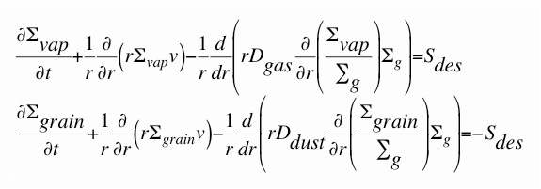
Basic Equations
Σ_{vap}, Σ_{grain} = surface densities of volatiles in gas and solid form
Σ_{g} = surface density of nebular gas
v = gas radial velocity
D_{gas} = gas diffusivity = viscosity
D_{dust} = dust diffusivity = D_{gas} / (1 + St^2)
S_{des} = source function of desorbed ices = f(Σ_{grain}, r, s, volatile properties)
Ciesla & Cuzzi (2006), Birnstiel et al. (2010, 2012)

Slide 31
Preliminary Results
Have solved the advection-diffusion equations without the source term => obtained the surface density evolution of solids (ignoring desorption for now)
Checked that results make sense physically

Slide 32
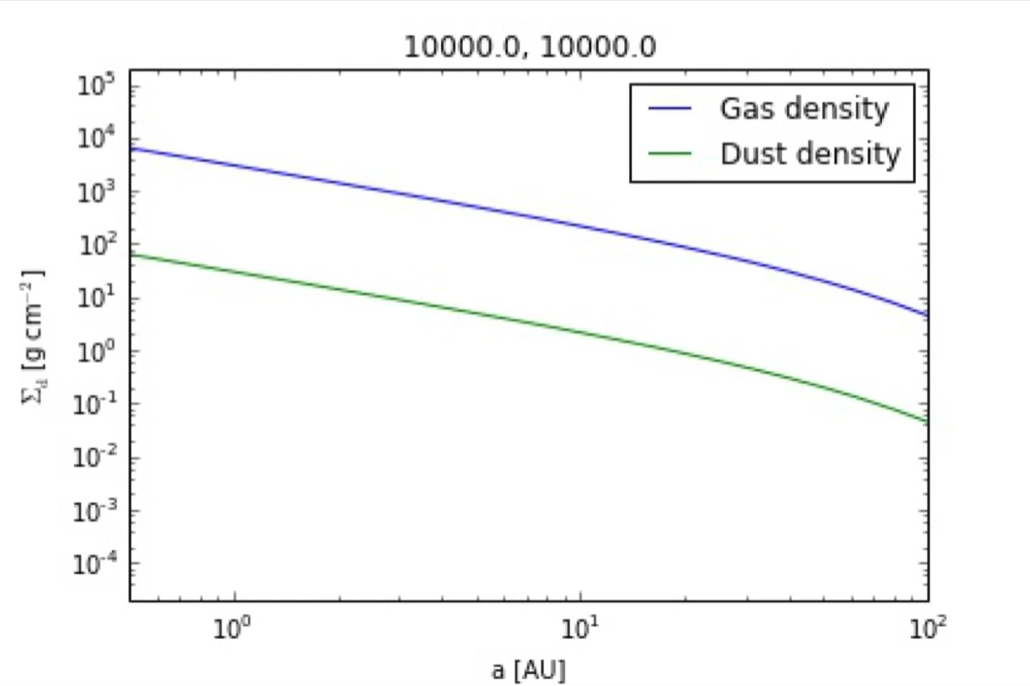
Determined profiles for gas and dust surface densities
s = 0.001 cm
alpha = 0.01, s = 0.001 cm

Slide 33
Determined profiles for gas and dust surface densities
s = 0.001 cm
alpha = 0.01, s = 1 km

Slide 34
Determined profiles for gas and dust surface densities
s = 0.001 cm
alpha = 0.01, s = 1 km
alpha = 0.01, s = 1 m

Slide 35
More preliminary results expected BEFORE defense
Solve the equations for H2O particles => determine O/H ratio
Notes:
-solve it for water

Slide 36
GOAL 2
Incorporate simple chemical evolution in coupled drift-desorption model
Collaborate with Ilse Cleeves
Results expected AFTER defense

Slide 37
Outline
Brief Background Info
Research Accomplished Since Last Meeting
Next Steps
Proposed Defense Timeline

Slide 38

GOOD NEWS
I have a job!

Slide 39
Thesis Outline
MAIN IDEA
The formation and composition of giant planets highly depends on disk location and properties.

Slide 40
Thesis Outline
Introduction
Minimum Core Masses for Giant Planet Formation at Wide Separations
Piso & Youdin 2014, ApJ, 786, 21
Piso, Youdin, & Murray-Clay 2015, ApJ, 800, 82
The Role of Disk Dynamics, Composition and Ice Morphology in Shaping Volatile Snowlines and the C/N/O Ratio
Piso, Oberg, Birnstiel, & Murray-Clay 2015, ApJ, 815, 109
Piso, Pegues, & Oberg 2016 (final stages)
The Effect of Time-Dependent Disk Dynamics on the C/N/O Ratio
Piso et al. 2016 (preliminary results as part of thesis)
Conclusion

Slide 41
Suggestions for External Examiner
Prof. Fred Ciesla (University of Chicago)
Dr. Margaret Pan (MIT)
Prof. Hilke Schlichting (MIT)

Slide 42
Thesis Timeline (and beyond)
GOAL
Officially graduate in spring 2016 => need to submit thesis to the registrar by May 13th

Slide 43
Thesis Timeline (and beyond)
By March 11th -> submit C/N/O paper
By March 25th -> apply for degree
March 11th – ~April 1st -> have some more preliminary results for the last thesis chapter
~April 1st – ~April 11th -> write thesis
Some time between April 25th and May 9th -> THESIS DEFENSE!
Mid-May – end of August -> develop intuition for chemistry and start developing a simple parameterized chemical network to implement in my dynamical model (collaborate closely with Ilse Cleeves)
End of August – early fall -> finish paper on last thesis chapter
September 1st -> START POSTDOC!
Notes:
Karin: here all week of April 25th; not May 3, 4, 5

Slide 44
Suggested Defense Dates (in order of preference)
May 6
May 9
April 28
April 27
May 2, April 29, 26, 25 -> other scheduled defenses

Slide 45
Conferences + Talks During Grad School
Past – 6 conferences (3 talks + 3 posters), 3 invited talks, 3 seminar talks
MIT Planetary Lunch Colloquium, Cambridge, MA, March 2016 -> Invited Talk
CfA Small Scale Seminar, Cambridge, MA, February 2016 -> Invited Talk
AAS 227th Meeting, Kissimmee, FL, January 2016 -> Dissertation Talk
Extreme Solar Systems III, Waikoloa, HI, December 2015 -> Poster
University of Michigan Lunch Talk, Ann Arbor, MI, November 2015 -> Contributed Talk
University of Chicago Exoplanet Journal Club, Chicago, IL, November 2015 -> Contributed Talk
MIT Exoplanet Tea, Cambridge, MA, September 2015 -> Contributed Talk
CIPS Seminar, Berkeley, CA, September 2015 -> Invited Talk
Star and Planet Formation in the Southwest, Oracle, AZ, March 2015 -> Contributed Talk
Protostars and Planets VI, Heidelberg, Germany, July 2013 -> Poster
IAUS 299: Exploring the Formation and Evolution of Planetary Systems, Victoria, BC, June 2013 -> Contributed Talk
Exoplanets in Multi-body Systems in the Kepler Era, Aspen, CO, February 2013 -> Poster
Future
ITC Luncheon, Cambridge, MA, April 2016 -> Invited Talk
Exoplanets I, Davos, Switzerland -> Contributed Talk (hopefully)

